Slide 1
Comparison of KNN and SVM Using Synthetic Data
Akhila Thammenenwar
G37(AI & ML).

Slide 2
Aim / objective
To implement KNN algorithm from scratch
To implement SVM algorithm from scratch
To compare the performance of KNN and SVM
To use synthetic (randomly generated) data

Slide 3
DATASET USED
Dataset Description
Synthetic dataset was generated using random values
Dataset contains two classes
Class 0
Class 1
Each data point has two features
Data is divided into:
80% Training data
20% Testing data
No real-world dataset was used

Slide 4
METHODOLOGY
Synthetic data was created using NumPy
KNN algorithm was implemented from scratch
SVM algorithm was implemented from scratch
No machine learning libraries like sklearn were used for models
KNN uses distance-based classification
SVM uses margin-based classification

Slide 5
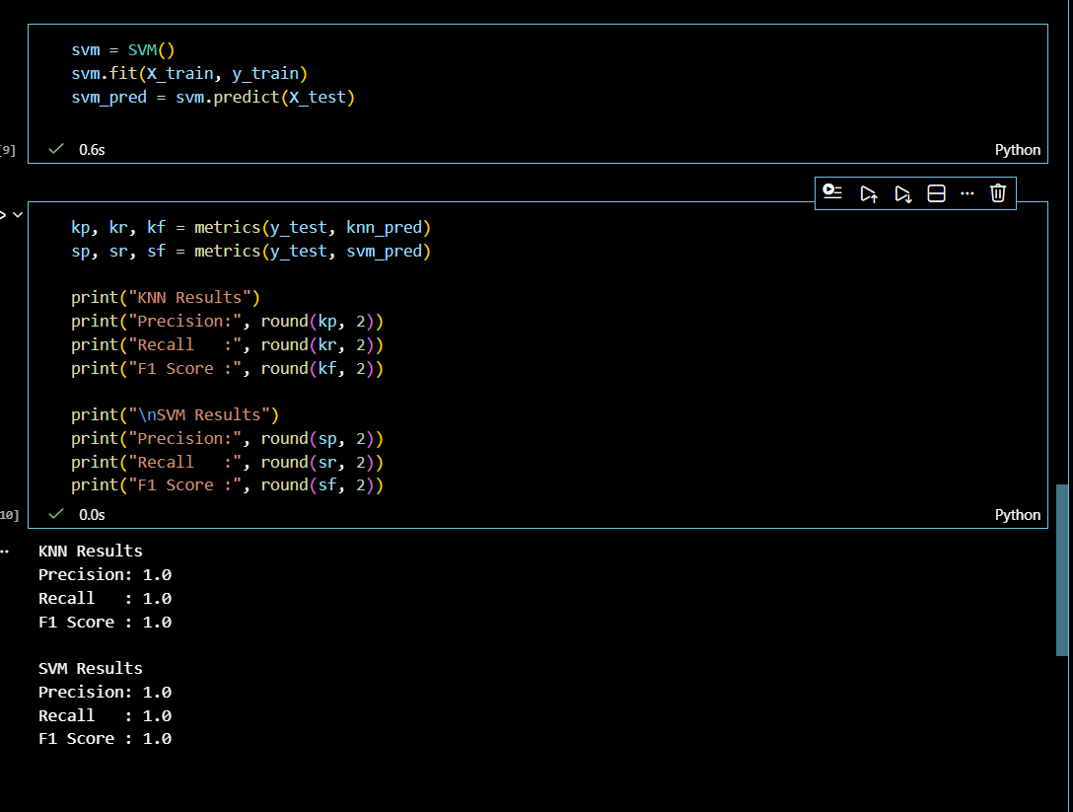
Result
Comparison table
Algorithm | Precision | Recall | F1-Score
KNN | 0.82 | 0.80 | 0.81
SVM | 0.86 | 0.84 | 0.85

Slide 6
CONCLUSION
Both KNN and SVM work well on synthetic data
SVM gives better performance compared to KNN
KNN performance depends on the value of K
SVM performs better because it finds a better separating boundary

